Slide 1

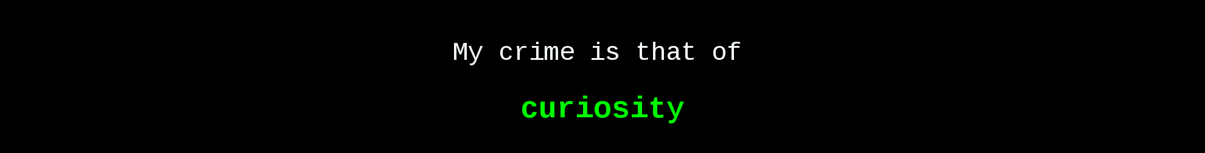
Web App Security
Topic 6

Slide 2
Web App Security
Topic 6
LEARNING OUTCOME
At the end of this lesson, you will be able to :
Describe the differences between XSS and CSRF.
Identify the target classification for each type of web app attack.
Perform each type of web app attack.

Slide 3
XSS vs CSRF
Web App Security
Topic 6
DIFFERENCE BETWEEN XSS & CSRF

Slide 4
XSS vs CSRF
Web App Security
Topic 6
DIFFERENCE BETWEEN
XSS → Allows an attacker to execute arbitrary JavaScript within the browser of a victim user.
Video >>
https://www.youtube.com/watch?v=ddcQ688eO7U
CSRF → Allows an attacker to induce a victim user to perform actions that they do not intend to.
Video >> https://www.youtube.com/watch?v=PBvFuVRCuMg

Slide 5
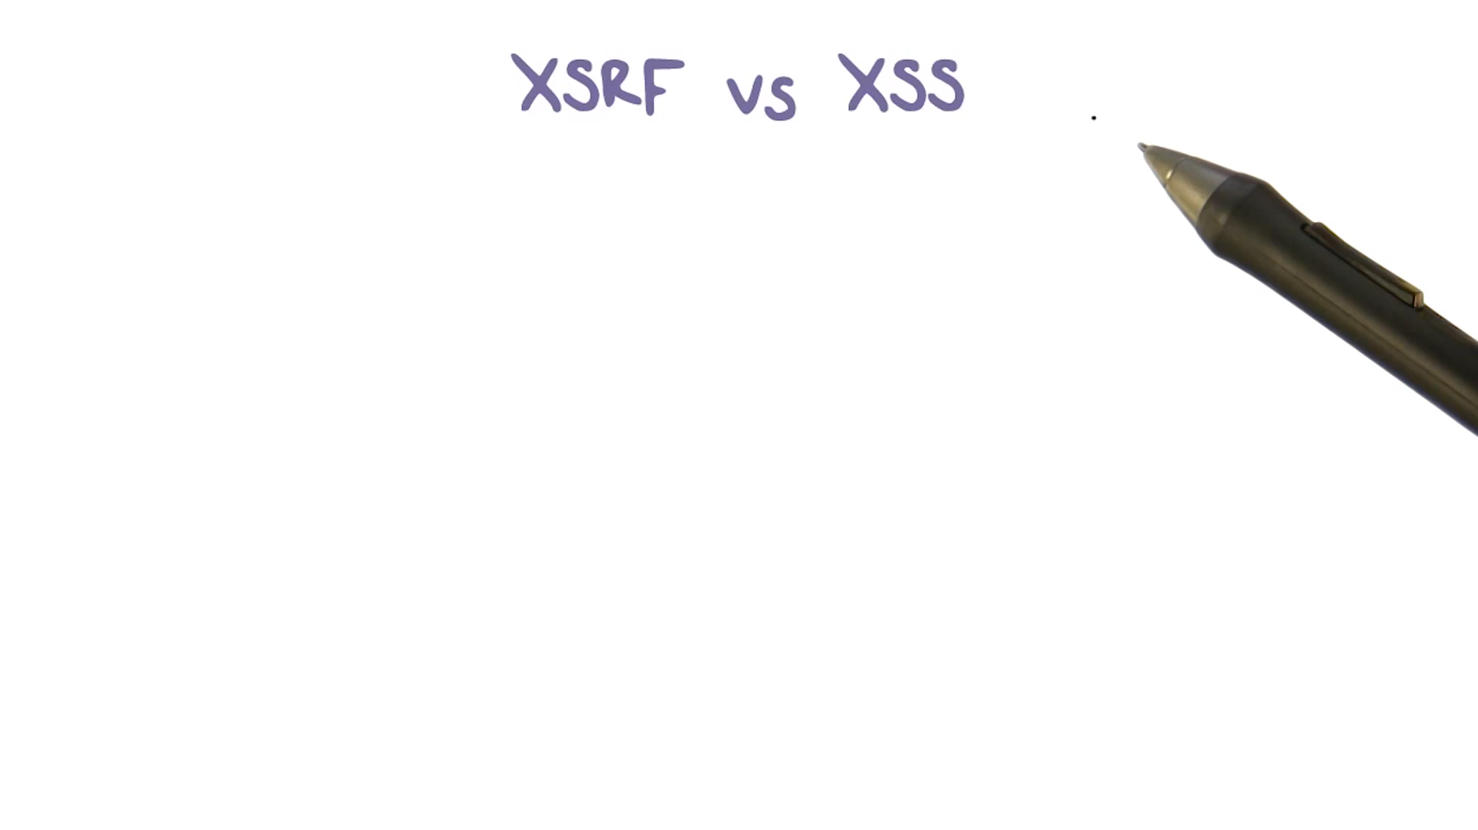
XSS vs CSRF
Web App Security
Topic 6
DIFFERENCE BETWEEN

Slide 6
Web App Security
Web App Security
Topic 6
WEB APP ATTACK TYPES - SUMMARISED
 | WEB APP SECURITY
Target | Individual | Organisation

Slide 7
Web App Security
Web App Security
Topic 6
WEB APP ATTACK TYPES - SUMMARISED
 | WEB APP SECURITY
Target | Individual | Organisation
Typical Objectives | Short-term immediate gains (esp transactional gains) | Info recon and manipulation for other parts of APT campaign.

Slide 8
Web App Security
Web App Security
Topic 6
WEB APP ATTACK TYPES - SUMMARISED
 | WEB APP SECURITY
Target | Individual | Organisation
Typical Objectives | Short-term immediate gains (esp transactional gains) | Info recon and manipulation for other parts of APT campaign.

Slide 9
Web App Security
Web App Security
Topic 6
WEB APP ATTACK TYPES - SUMMARISED
 | WEB APP SECURITY
Target | Individual | Organisation
Typical Objectives | Short-term immediate gains (esp transactional gains) | Info recon and manipulation for other parts of APT campaign.
Typical Style | Social Eng | MITM | Hackings on websites

Slide 10
Web App Security
Web App Security
Topic 6
WEB APP ATTACK TYPES - SUMMARISED
 | WEB APP SECURITY
Target | Individual | Organisation
Typical Objectives | Short-term immediate gains (esp transactional gains) | Info recon and manipulation for other parts of APT campaign.
Typical Style | Social Eng | MITM | Hackings on websites

Slide 11
Web App Security
Web App Security
Topic 6
WEB APP ATTACK TYPES - SUMMARISED
 | WEB APP SECURITY
Target | Individual |  |  | Organisation
Typical Objectives | Short-term immediate gains (esp transactional gains) |  |  | Info recon and manipulation for other parts of APT campaign.
Typical Style | Social Eng | MITM |  |  | Hackings on websites
Common Methods | XSS | CSRF | Session Hijacking | Forced Browsing/ Authentication bypass | File Inclusion | SQL Injection | Web Login Brute Forcing
Specific Methods/ Tools/ Exploited weaknesses | Reflected |  |  | Burpsuite | Directory Traversal |  | Burpsuite
 | Stored |  |  | Manual | Local file inclusion |  | OWASP WebScarab
 | DOM |  |  |  | Remote file inclusion |  | Paros Proxy
Exercises | Exercises 3 and 4 | Exercises 5 | N/A | Exercises 6, 8, 14, 15, 16 | Exercises 9 | Exercise 7, 17, 18 | Exercises 10

Slide 12
Web App Security
Web App Security
Topic 6
WEB APP ATTACK TYPES - SUMMARISED
 | WEB APP SECURITY
Target | Individual |  |  | Organisation
Typical Objectives | Short-term immediate gains (esp transactional gains) |  |  | Info recon and manipulation for other parts of APT campaign.
Typical Style | Social Eng | MITM |  |  | Hackings on websites
Common Methods | XSS | CSRF | Session Hijacking | Forced Browsing/ Authentication bypass | File Inclusion | SQL Injection | Web Login Brute Forcing
Specific Methods/ Tools/ Exploited weaknesses | Reflected |  |  | Burpsuite | Directory Traversal |  | Burpsuite
 | Stored |  |  | Manual | Local file inclusion |  | OWASP WebScarab
 | DOM |  |  |  | Remote file inclusion |  | Paros Proxy
Exercises | Exercises 3 and 4 | Exercises 5 | N/A | Exercises 6, 8, 14, 15, 16 | Exercises 9 | Exercise 7, 17, 18 | Exercises 10

Slide 13
Web App Security
Web App Security
Topic 6
WEB APP ATTACK TYPES - SUMMARISED
 | WEB APP SECURITY
Target | Individual |  |  | Organisation
Typical Objectives | Short-term immediate gains (esp transactional gains) |  |  | Info recon and manipulation for other parts of APT campaign.
Typical Style | Social Eng | MITM |  |  | Hackings on websites
Common Methods | XSS | CSRF | Session Hijacking | Forced Browsing/ Authentication bypass | File Inclusion | SQL Injection | Web Login Brute Forcing
Specific Methods/ Tools/ Exploited weaknesses | Reflected |  |  | Burpsuite | Directory Traversal |  | Burpsuite
 | Stored |  |  | Manual | Local file inclusion |  | OWASP WebScarab
 | DOM |  |  |  | Remote file inclusion |  | Paros Proxy
Exercises | Exercises 3 and 4 | Exercises 5 | N/A | Exercises 6, 8, 14, 15, 16 | Exercises 9 | Exercise 7, 17, 18 | Exercises 10

Slide 14
Web App Security
Web App Security
Topic 6
WEB APP ATTACK TYPES - SUMMARISED
 | WEB APP SECURITY
Target | Individual |  |  | Organisation
Typical Objectives | Short-term immediate gains (esp transactional gains) |  |  | Info recon and manipulation for other parts of APT campaign.
Typical Style | Social Eng | MITM |  |  | Hackings on websites
Common Methods | XSS | CSRF | Session Hijacking | Forced Browsing/ Authentication bypass | File Inclusion | SQL Injection | Web Login Brute Forcing
Specific Methods/ Tools/ Exploited weaknesses | Reflected |  |  | Burpsuite | Directory Traversal |  | Burpsuite
 | Stored |  |  | Manual | Local file inclusion |  | OWASP WebScarab
 | DOM |  |  |  | Remote file inclusion |  | Paros Proxy
Exercises | Exercises 3 and 4 | Exercises 5 | N/A | Exercises 6, 8, 14, 15, 16 | Exercises 9 | Exercise 7, 17, 18 | Exercises 10

Slide 15
Web App Security
Web App Security
Topic 6
WEB APP ATTACK TYPES - SUMMARISED
 | WEB APP SECURITY
Target | Individual |  |  | Organisation
Typical Objectives | Short-term immediate gains (esp transactional gains) |  |  | Info recon and manipulation for other parts of APT campaign.
Typical Style | Social Eng | MITM |  |  | Hackings on websites
Common Methods | XSS | CSRF | Session Hijacking | Forced Browsing/ Authentication bypass | File Inclusion | SQL Injection | Web Login Brute Forcing
Specific Methods/ Tools/ Exploited weaknesses | Reflected |  |  | Burpsuite | Directory Traversal |  | Burpsuite
 | Stored |  |  | Manual | Local file inclusion |  | OWASP WebScarab
 | DOM |  |  |  | Remote file inclusion |  | Paros Proxy
Exercises | Exercises 3 and 4 | Exercises 5 | N/A | Exercises 6, 8, 14, 15, 16 | Exercises 9 | Exercise 7, 17, 18 | Exercises 10

Slide 16
Web App Security
Web App Security
Topic 6
WEB APP ATTACK TYPES - SUMMARISED
 | WEB APP SECURITY
Target | Individual |  |  | Organisation
Typical Objectives | Short-term immediate gains (esp transactional gains) |  |  | Info recon and manipulation for other parts of APT campaign.
Typical Style | Social Eng | MITM |  |  | Hackings on websites
Common Methods | XSS | CSRF | Session Hijacking | Forced Browsing/ Authentication bypass | File Inclusion | SQL Injection | Web Login Brute Forcing
Specific Methods/ Tools/ Exploited weaknesses | Reflected |  |  | Burpsuite | Directory Traversal |  | Burpsuite
 | Stored |  |  | Manual | Local file inclusion |  | OWASP WebScarab
 | DOM |  |  |  | Remote file inclusion |  | Paros Proxy
Exercises | Exercises 3 and 4 | Exercises 5 | N/A | Exercises 6, 8, 14, 15, 16 | Exercises 9 | Exercise 7, 17, 18 | Exercises 10

Slide 17
Web App Security
Web App Security
Topic 6
WEB APP ATTACK TYPES - SUMMARISED
 | WEB APP SECURITY
Target | Individual |  |  | Organisation
Typical Objectives | Short-term immediate gains (esp transactional gains) |  |  | Info recon and manipulation for other parts of APT campaign.
Typical Style | Social Eng | MITM |  |  | Hackings on websites
Common Methods | XSS | CSRF | Session Hijacking | Forced Browsing/ Authentication bypass | File Inclusion | SQL Injection | Web Login Brute Forcing
Specific Methods/ Tools/ Exploited weaknesses | Reflected |  |  | Burpsuite | Directory Traversal |  | Burpsuite
 | Stored |  |  | Manual | Local file inclusion |  | OWASP WebScarab
 | DOM |  |  |  | Remote file inclusion |  | Paros Proxy
Exercises | Exercises 3 and 4 | Exercises 5 | N/A | Exercises 6, 8, 14, 15, 16 | Exercises 9 | Exercise 7, 17, 18 | Exercises 10

Slide 18


